Slide 1
South Carolina DOT Training Workshop
Geophysics Field Testing Methods, Data Reduction, and Interpretation of Results
Robert C. Bachus and Glenn J. Rix
June 5 – 26, 2020

Slide 2
In Situ Seismic Methods
Invasive
  Crosshole method (ASTM D4428)
  Downhole method (ASTM D7400)
    Cased borehole
    Seismic cone penetrometer (SCPTu)
  Suspension logging
Non-invasive
  Surface wave methods
    Spectral Analysis of Surface Waves (SASW)
    Multi-channel Analysis of Surface Waves (MASW)
    Microtremor Array Measurements (MAM)
  Seismic refraction (ASTM D5777)
  Seismic reflection (ASTM D7128)

Slide 3
Seismic Refraction

Slide 4
Acquisition
Source
Receivers (1-96)
x
V₁
H
V₂

Slide 5
Seismic Refraction
Direct Wave
V₁
H
V₂

Slide 6
Seismic Refraction

Slide 7
Seismic Refraction
V₁
H
Critically Refracted Wave
V₂

Slide 8
Seismic Refraction

Slide 9

Seismic Refraction
$$x_{c}$$

Slide 10
Seismic Refraction
Source
H₁
V₁
H₂
V₂
V₃

Slide 11
Seismic Refraction

Slide 12
Seismic Refraction
z_{1A}
V₁
θ
V₂
V₁
z_{1B}
θ
V₂

Slide 13
Seismic Refraction

Slide 14
Seismic Refraction

Slide 15
Seismic Refraction
Two Equations – Two Unknowns

Slide 16
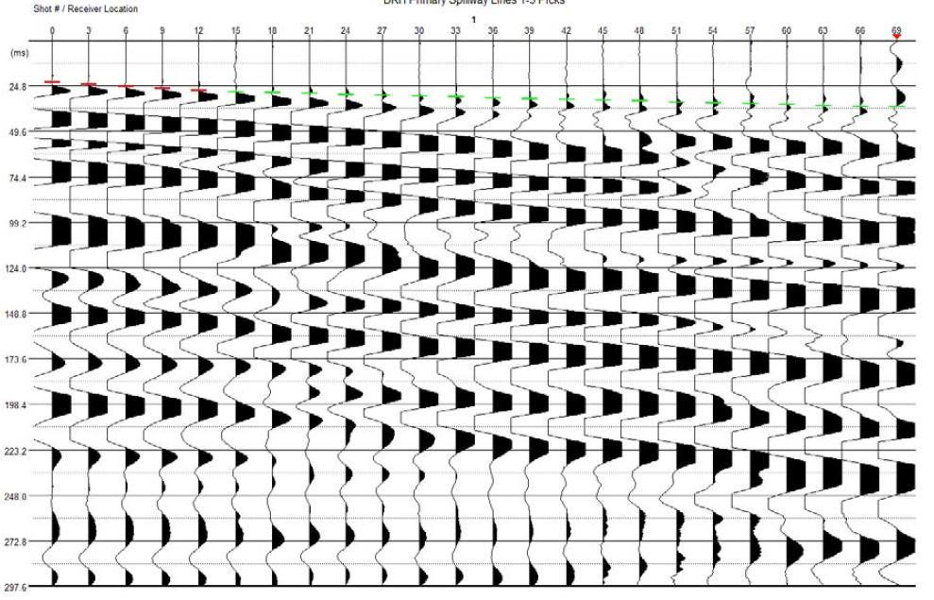
Seismic Refraction Examples
Source
24 receivers @ 3-ft spacing
24 receivers @ 3-ft spacing
X
Shot 1
Shot 2

Slide 17
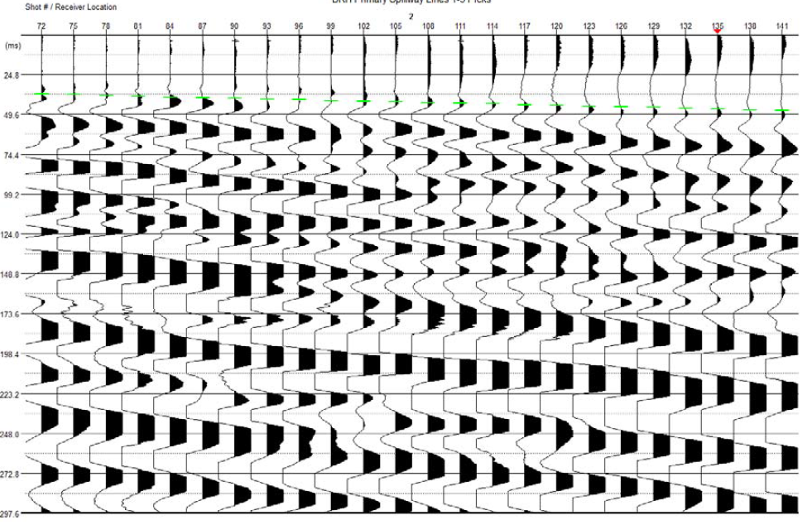
Seismic Refraction Examples
Source
24 receivers @ 3-ft spacing
24 receivers @ 3-ft spacing
X
Shot 1
Shot 2

Slide 18
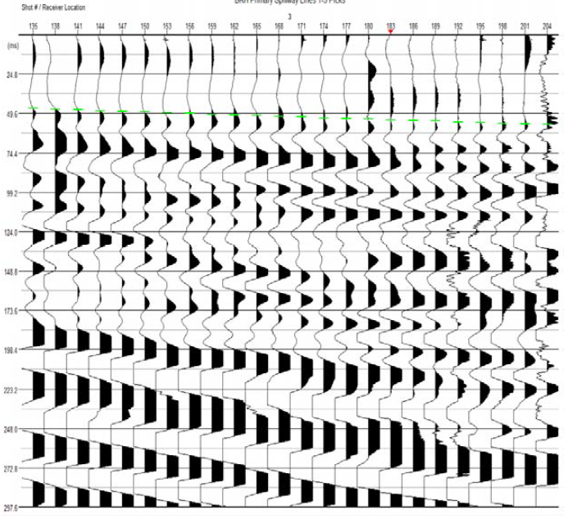
Seismic Refraction Examples
Source
24 receivers @ 3-ft spacing
24 receivers @ 3-ft spacing
X
Shot 2
Shot 3

Slide 19
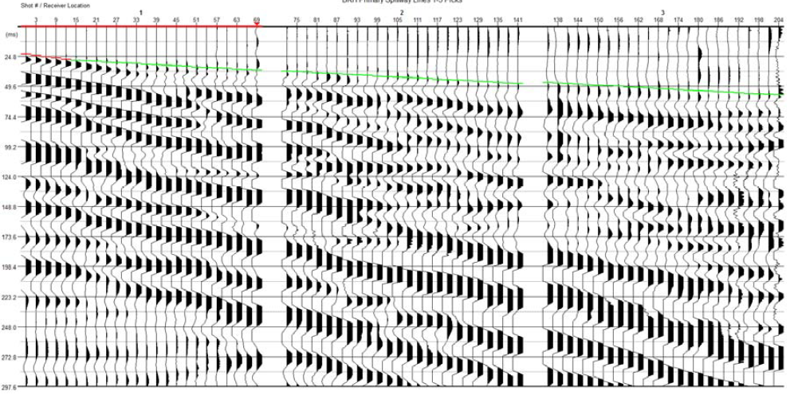
Seismic Refraction Examples

Slide 20
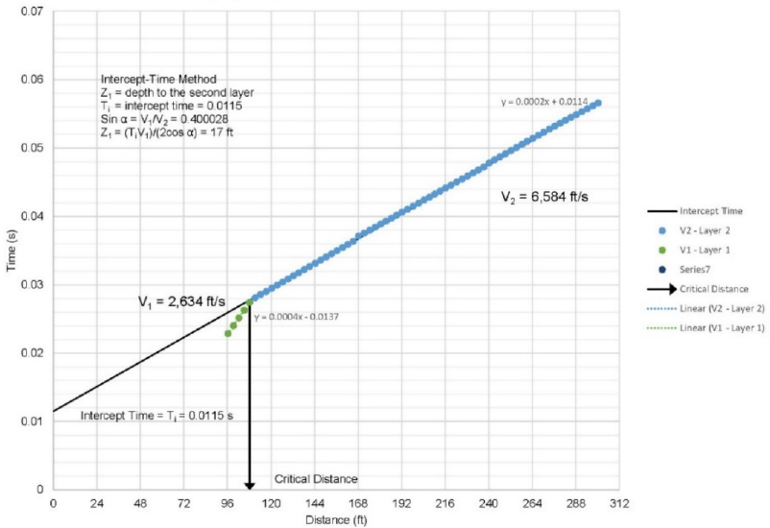
Seismic Refraction Examples

Slide 21
Seismic Refraction Interpretation
Time Intercept and Crossover Distance Methods (planar refractors)
Common Reciprocal Methods (non-planar refractors)
  Plus-Minus Method
  ABC Method
  Hagiwaras Method
Generalized Reciprocal Methods (non-planar refractors)
  Delay Time Method
  Hales Method

Slide 22
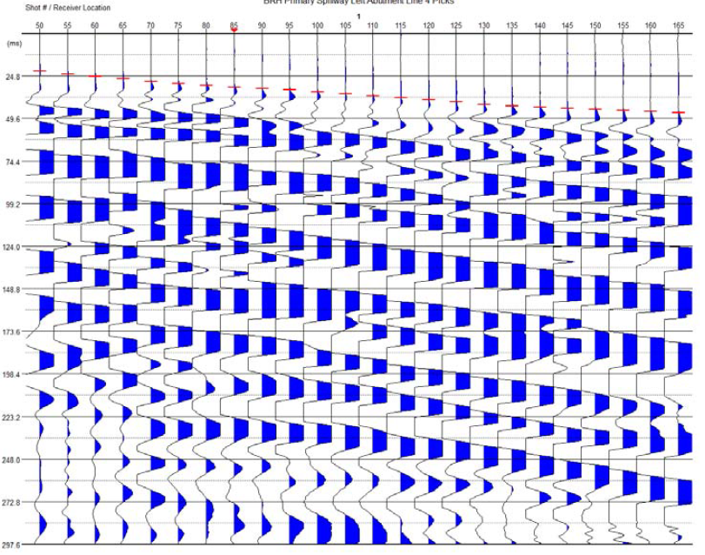
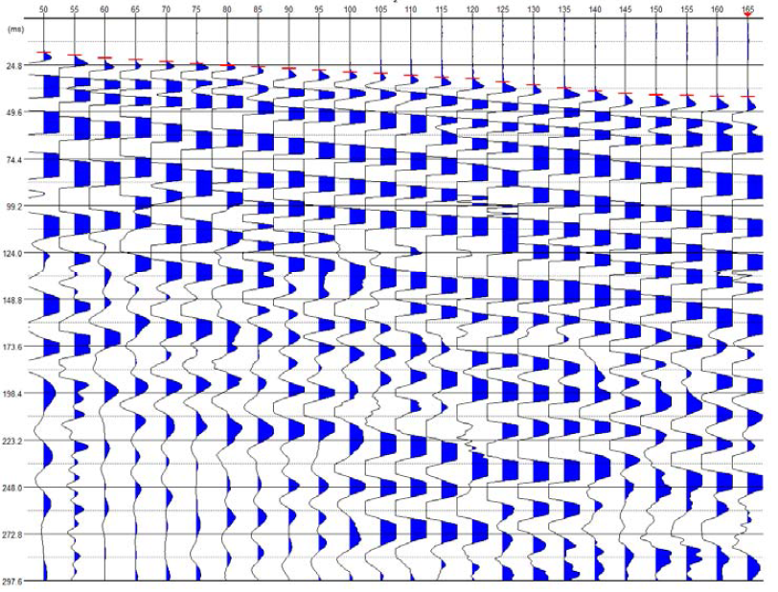
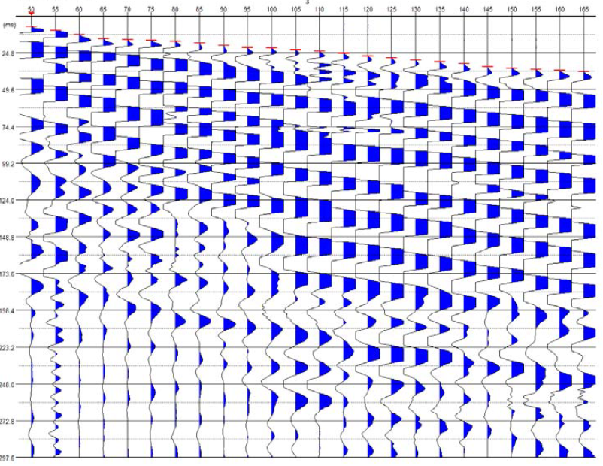
Seismic Refraction Tomography
Shot 1
Shot 2
Shot 3

Slide 23
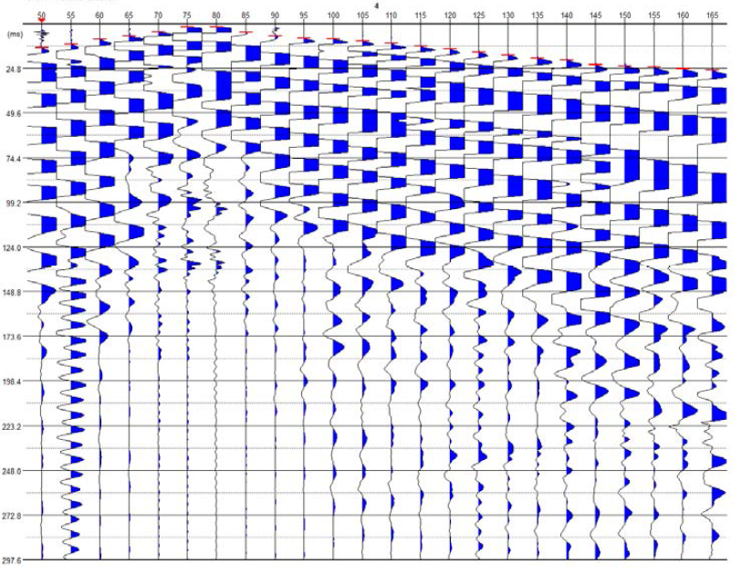
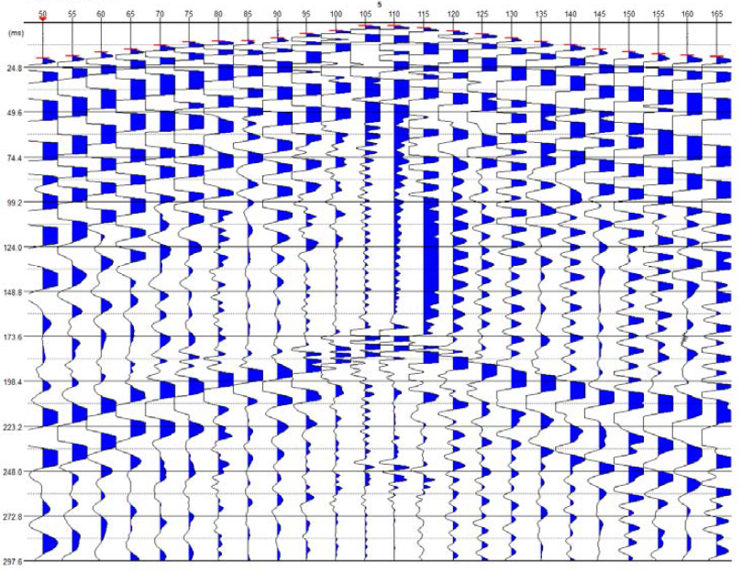
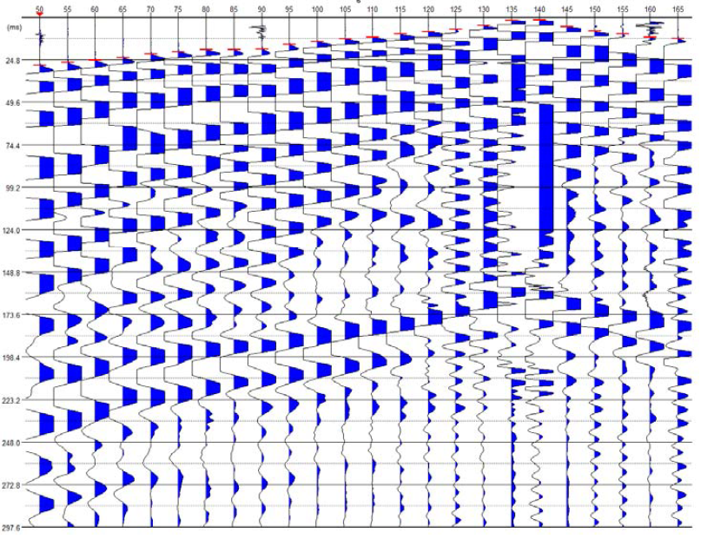
Seismic Refraction Tomography
Shot 4
Shot 5
Shot 6

Slide 24
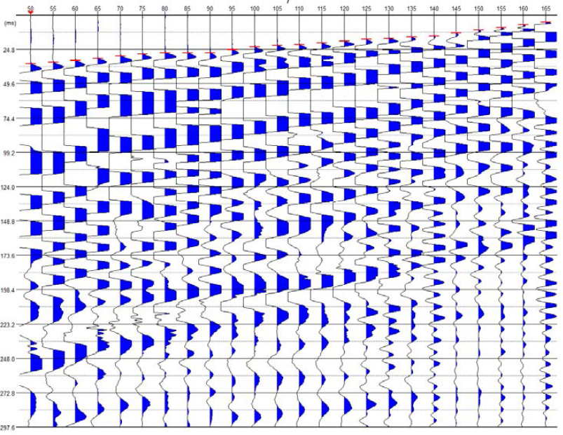
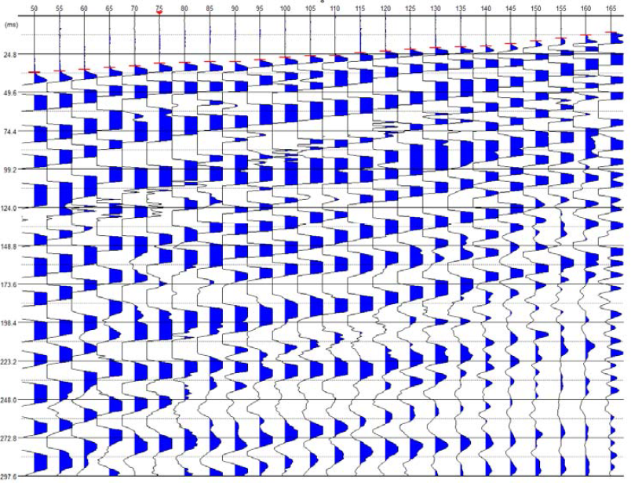
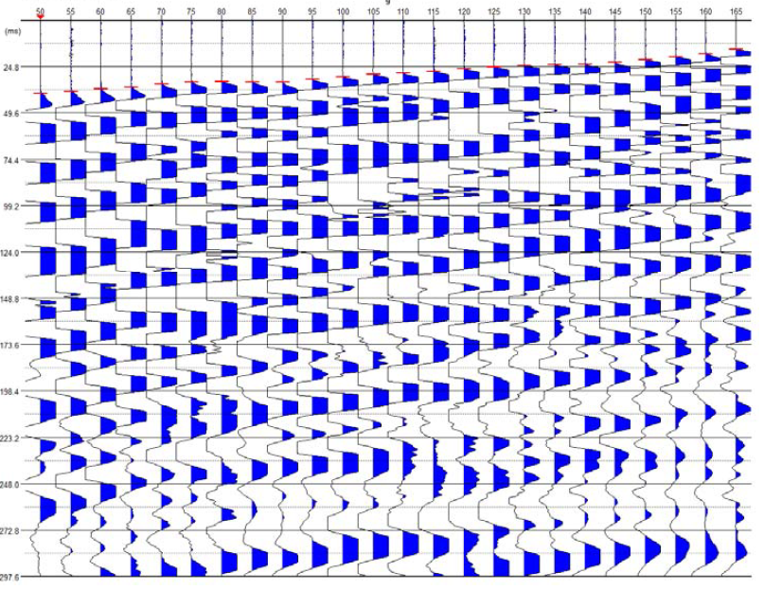
Seismic Refraction Tomography
Shot 7
Shot 8
Shot 9

Slide 25
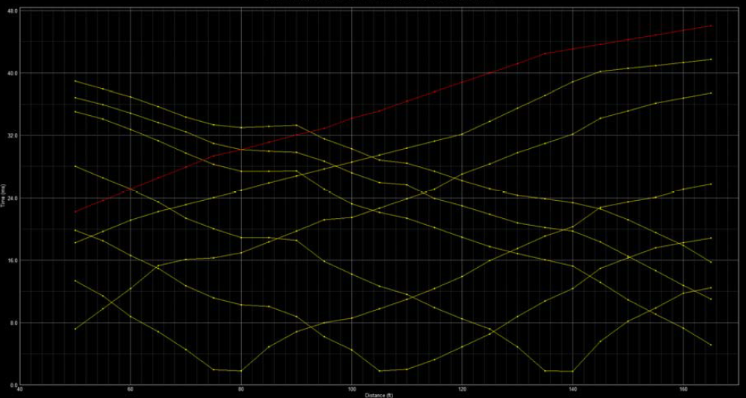
Seismic Refraction Tomography
Shot 1
Shot 2
Shot 9
Shot 8
Shot 3
Shot 7
Shot 4
Shot 5
Shot 6

Slide 26
Seismic Refraction Tomography
The two-dimensional (2D) velocity structure is estimated by minimizing the difference between predicted and observed first-arrival travel times (i.e., an inversion procedure).

Slide 27
Seismic Refraction Tomography
Assume initial 2D velocity profile
Calculate predicted travel times using ray tracing
Compare predicted and measured travel times
Adjust 2D velocity profile
Satisfactory
agreement?
Final 2D velocity profile

Slide 28
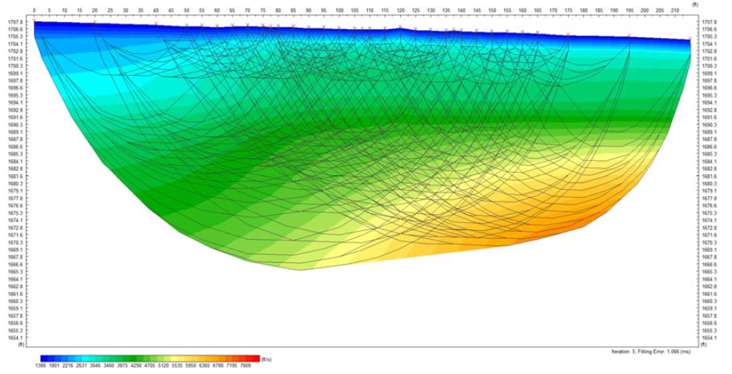
Seismic Refraction Tomography
0 ft
210 ft
El. 1707 ft
Shot 1
Shot 2
Shot 3
Shot 4
Shot 5
Shot 6
Shot 7
Shot 8
Shot 9
El. 1665 ft
Compression Wave Velocity
Iteration 5: Fitting Error 1.066 msec
1386 ft/sec
7609 ft/sec

Slide 29
Classic Application of Refraction
Source: Caterpillar

Slide 30
Seismic Refraction
Strengths
  Noninvasive
  Based on interpretation of first arrivals
  Seismic refraction tomography improves the power and flexibility of the test
Limitations
  Hidden layer and thin layer problems
  When conducted using compression waves, of limited value in saturated soils

